Slide 1
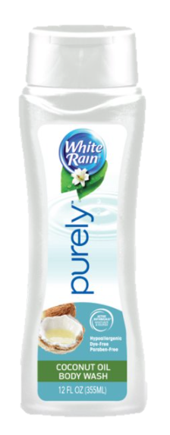
White Rain Purely 12oz
Mild, Moisturizing Body Wash with a Fresh scent for gentle cleansing
Hypoallergenic, Dye Free and Paraben Free
Made with Coconut oils to nourish and moisturize while gently cleansing your skin

Slide 2
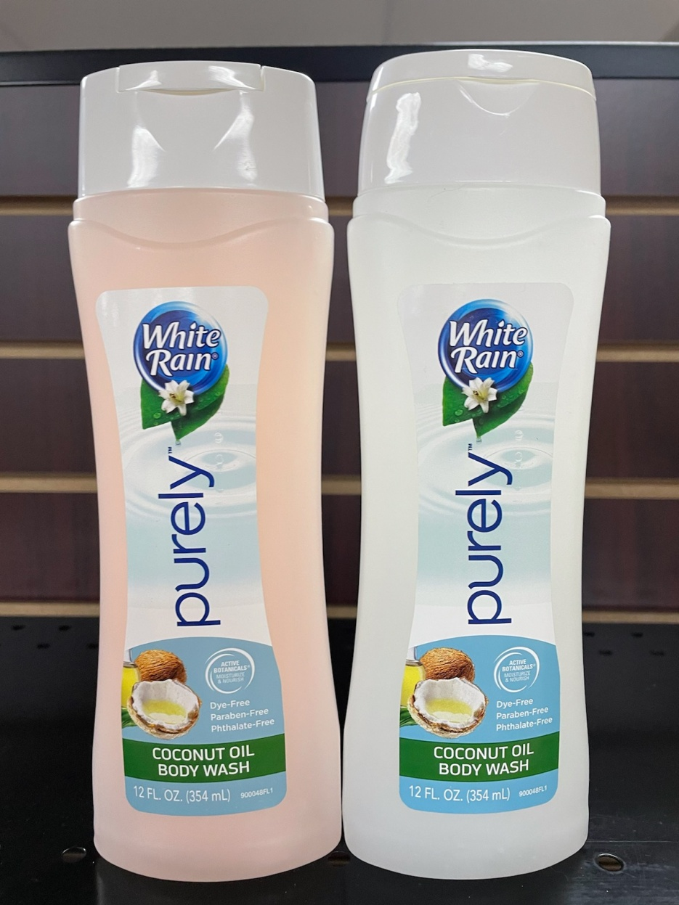
Product Discolored by Fragrance reaction
Closeout Truckload
240cs/pallet 28/pallet = 40320/units
,

